Slide 1
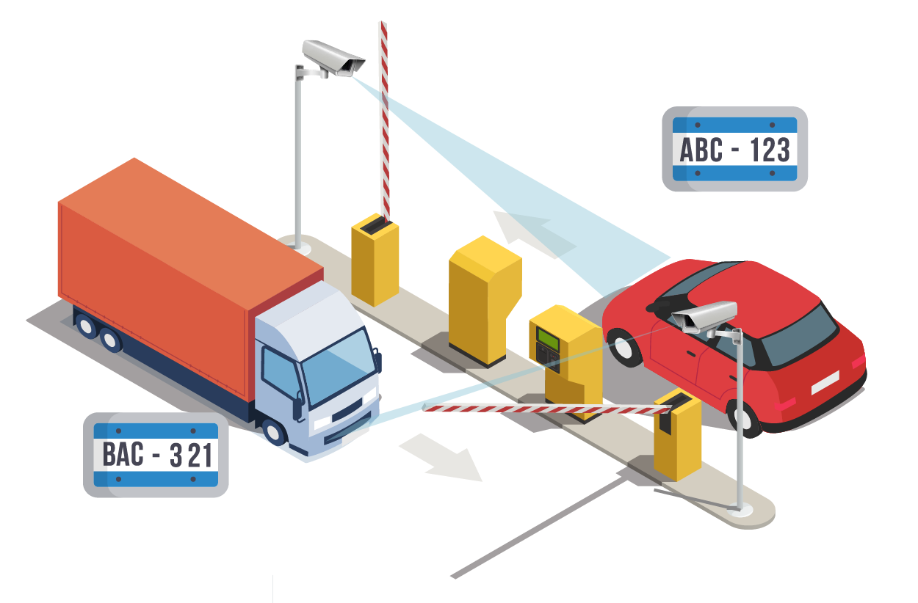


License Number Plate Recognition and Identification using MATLAB
Saurabh Tamta (190050102047)
Mohit Bohra (190050102030)
Mentor : Mr. Anoop Raghuvanshi
HOD: Mr. Anil Chaurasia

Slide 2
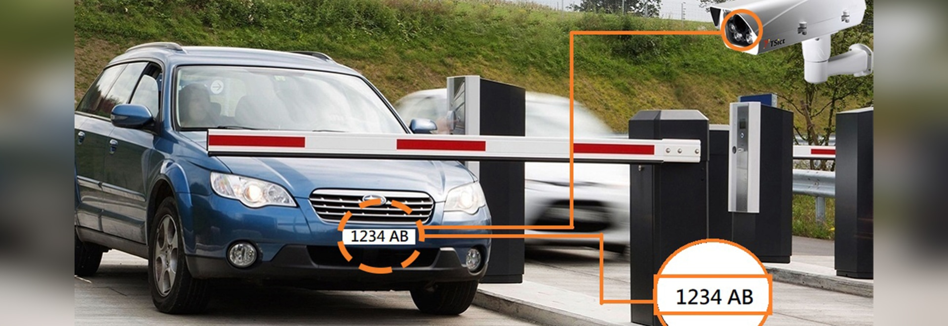
Content
Introduction.
Objective of the Project.
Need and Applications.
Block diagram of image processing.
Complete Steps.
Image acquisition.
Image Binarization.
Image Segmentation.
Character Recognition.
Character Normalization.
Database data matching.
Arduino uno SMD with micro-controller Atmega328
Functional Gate.
Conclusion.
2

Slide 3
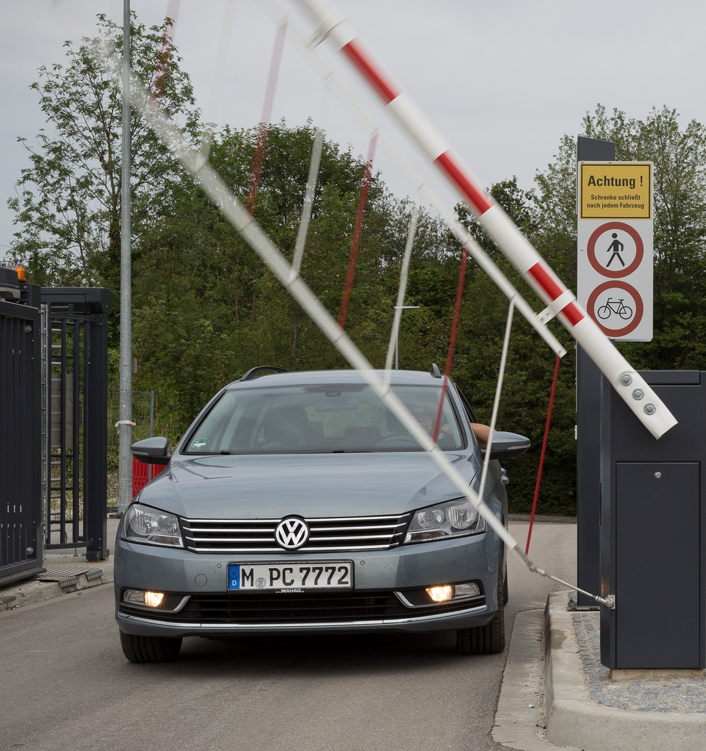
Introduction
This presentation will discuss the development of a MATLAB-based license plate reader and automatic gate system that streamlines access control. By automating the process of identifying and validating vehicles, this system can increase security, reduce wait time, and lower labor costs.
3

Slide 4
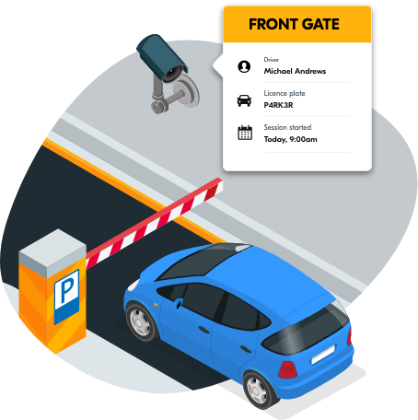
Objective of the Project
Acquiring the image through an input camera.
Processing the image though MATLAB and extracting the number plate text.
Checking the number plate in the database.
Controlling gate desirably.
4

Slide 5
Needs and Applications
Schools and colleges
Toll plaza
Hospitals
Parking
Military
Can be used in schools and colleges gates for security and reduces human labor.
Can be used at toll Plaza to manage traffic, save time and manage database of tolls.
Can be used at hospitals by authorizing verified vehicles.
Can be used at parking to manage cars, save time and human labor
Can also be used by the military to control security and grant only authorized vehicles to enter.
5

Slide 6
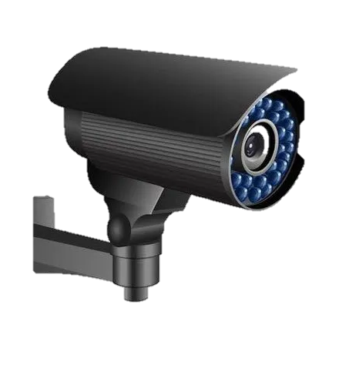
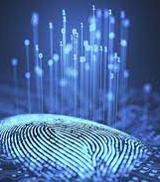
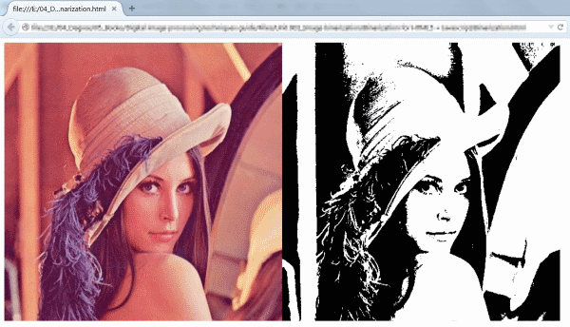
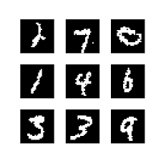
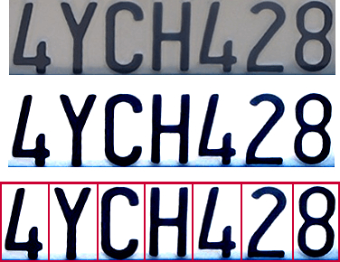
Block diagram of image processing.
Image Acquisition
Image Processing
Image Binarization
Image Segmentation
Character recognition
Conversion of image to digital form for further processing
Acquiring the image through a camera.
Conversion of image into binarized format.
Converting an image into a collection of regions of pixels
Characters are recognized using various algorithms.
6

Slide 7
Complete Steps
Image Processing
Arduino uno
Acquired image will be processed by MATLAB and the text in the number plate is extracted.
MATLAB and Arduino runs as center of command. Arduino uno controls the gate as per the MATLAB commands.
Image Acquisition
Camera clicks photo only when car is in specified range of the ultrasonic sensor.
Verification
Database Matching
If the number plate is verified then MATLAB sends command to Arduino uno.
The output extracted text will be matched in the database.
7

Slide 8
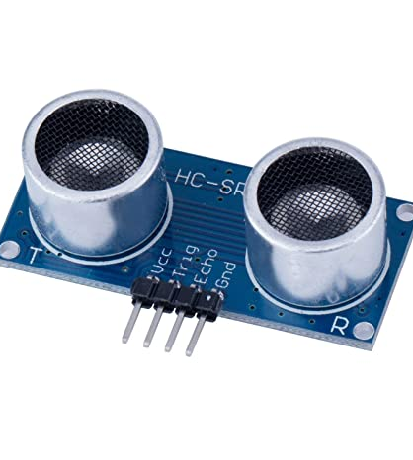
HC- SR04 DC 5V Ultrasonic Sensor
The HC-SR04 Ultrasonic Distance Sensor provides very short (2CM) to long-range (4M) detection and ranging. It can be easily interfaced to any microcontroller.
When a car comes in range of the ultrasonic sensor, the camera starts clicking photos of the number plate.
8

Slide 9
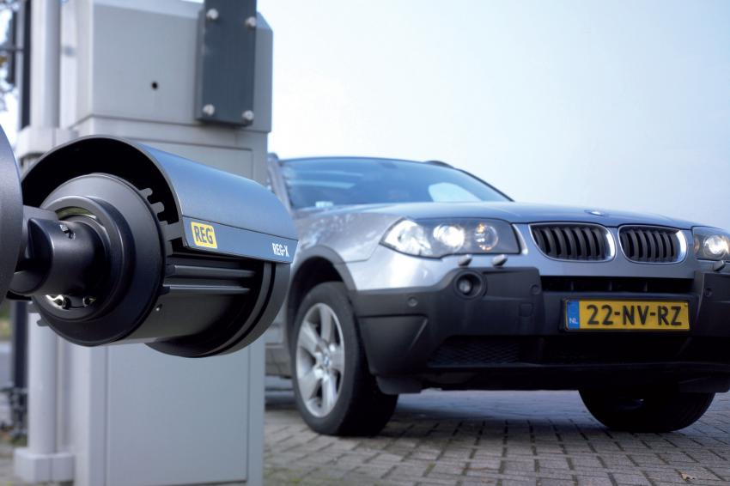
Image Acquisition
Image Acquisition can be defined as the act of procuring an image from sources. This can be done via hardware systems such as cameras, encoders, sensors, etc.
First step acquires the image and saves in into a folder or database.
imread() – This command is used to open the image into the MATLAB from the target folder.
9

Slide 10
Image Binarization
The conversion of document image into bi-level document image. Image pixels are separated into dual collection of pixels, i.e. black and white.
imbinarize() – This command is used to Binarize 2-D grayscale image or simply we can say it converts the image into black and white format.
10

Slide 11
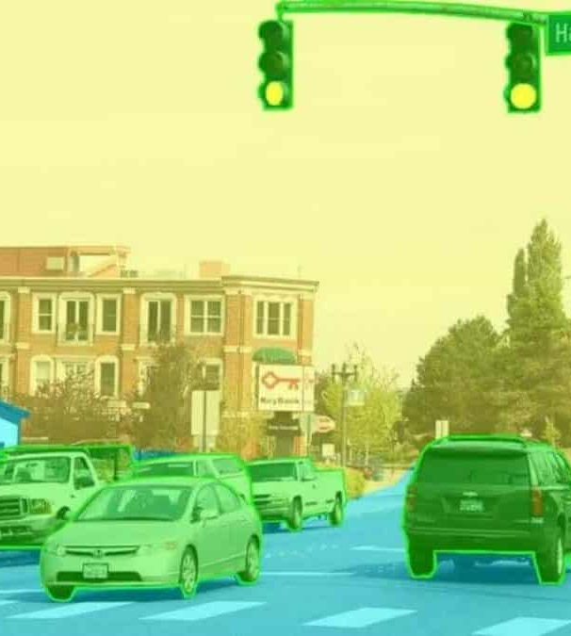
Image Segmentation
Converting an image into a collection of regions of pixels that are represented by a mask or a labeled image. By dividing an image into segments, you can process only the important segments of the image instead of processing the entire image.
For example, a common application of image segmentation in medical imaging is to detect and label pixels in an image or voxels of a 3D volume that represent a tumor in patients brain or other organs.
.
11

Slide 12
Character Normalization
Normalization is to refine the characters into a block containing no extra white spaces in all four sides of the characters.
Sometimes called contrast stretching.
Then each character should be equal in size.
edge() – This command is used to detect the edges in the image, by using various methods like Roberts, Sobel, Prewitt and many others
numel() – This command is used to calculate the number of array elements.
12

Slide 13
Character Recognition
The essential point of binarization is the thresholding.
By thresholding the pixel values of 0(black) for all of image with luminance less than threshold value and 1(white) for all other pixels.
The Binarized segment is matched with characters images present in the alpha folder.
13

Slide 14

Database data Matching
Database
MySQL
MATLAB
Arduino uno
The text thus obtained from the number plate is then compared to the data present in the database. Here we used MySQL based database.
If the text data matches the data present in the database then that response will be sent to MATLAB and MATLAB will send appropriate response to Arduino uno.
Micro-controller

Slide 15
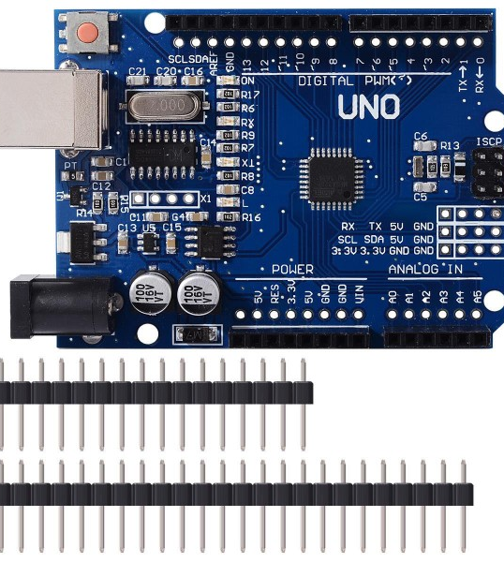
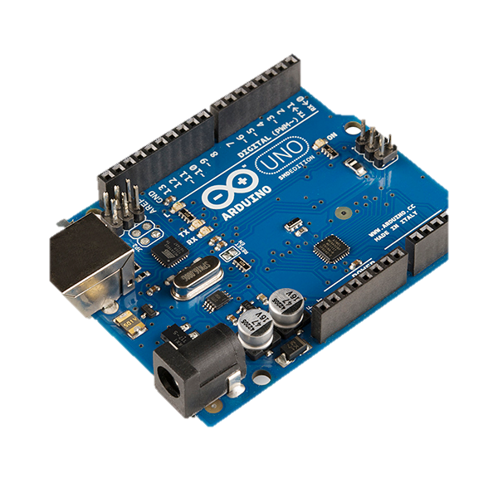

Arduino uno SMD with micro-controller Atmega328
What is Arduino and Arduino uno ?
Arduino is an open-source electronics platform based on easy-to-use hardware and software.
The Arduino Uno is an open-source microcontroller board based on the Microchip ATmega328P microcontroller.
Features of Arduino uno.
The chip on the board plugs straight into your USB port and supports your computer as a virtual serial port.
It is easy to find the microcontroller brain which is the ATmega328 chip.
It is a 16 MHz clock which is fast enough for most applications and does not speed up the microcontroller.
It has 32 KB of flash memory for storing your code. An on-board LED is attached to digital pin 13 to make fast the debugging of code and to make the debug process easy.
15

Slide 16
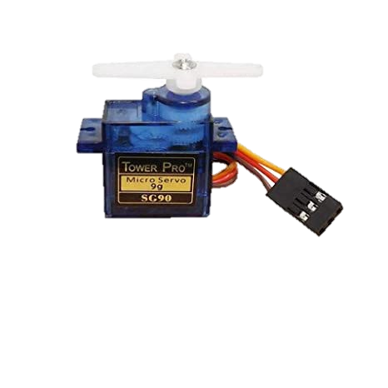
Functional Gate
Functional gate.
If the vehicle number plate is verified then the gate will open.
We can use microcontroller to control the movements of the gate.
Micro Servo Motor SG90
Here in the Project we have used Micro/Mini SG90 Servo motor with 180 degree rotation.
The ATmega328 chip i.e., a micro-controller which comes with Arduino uno, helps us in controlling the motor.
Servo code hardware or library can be used to control this servo motor.
Specifications - Operating Voltage (VDC):3.0 ~ 7.2 | Operating Speed @4.8V:0.12sec/60° | Operating Speed @6.6V:0.1sec/60° | Stall Torque @ 4.8V (Kg-Cm):1.2 | Operating Temperature (°C):-30 to 60|
16

Slide 17
Conclusion
We have implemented number plate recognition. The algorithm detects the number plate region from the image which consists the vehicle number. We have applied our algorithm on many images and found that it successfully recognizes the number plate. The project was designed keeping in mind the automatic plate detection and gate automation which could replace the current system of manual entry.
17

Slide 18
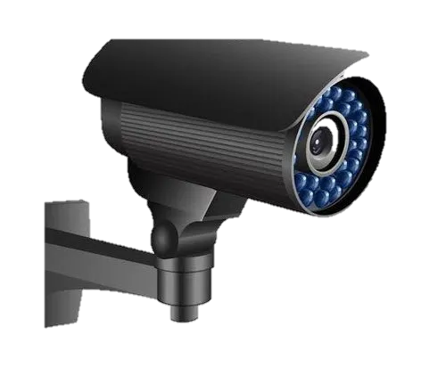
Thank you

